Slide 1

Introduction to Image Analysis: Ilastik
3. Advanced Segmentation: Pixel classification
Noreen Walker, Gayathri Nadar
Scientific Computing Facility, MPI-CBG
3.-7.5.2021
Aim of this session:
Introduction machine learning
Segmentation with machine learning: random forest
Ilastik tool
Material on machine learning concepts:
Adapted from: Ignacio Arganda-Carreras (Neubias school 2020)

Slide 2
Course schedule
Day 1 (Mon 3.5.)
Image basics, visualization, measurements
Spot detection
Segmentation (start)
Day 2 (Tue 4.5.)
Visit LMF
Segmentation (cont’d)
Mathematical background: image filters, morphology
Day 3 (Wed 5.5.)
Advanced segmentation: Machine learning with Ilastik
IJ Macro (start)
Day 4 (Thu 6.5.)
IJ Macro (cont’d)
3D data: visualization and analysis
Day 5 (Fri 7.5.)
Image registration, image stitching
Time sequence analysis and tracking
Good practices

Slide 3
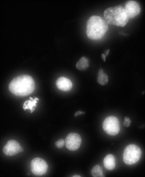
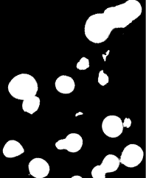
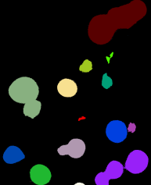
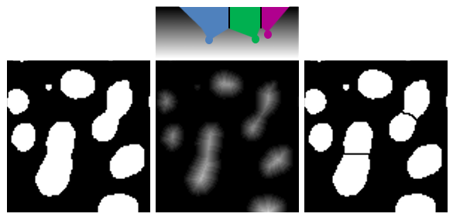
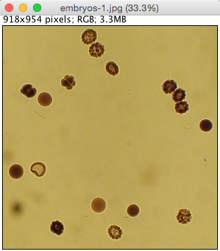
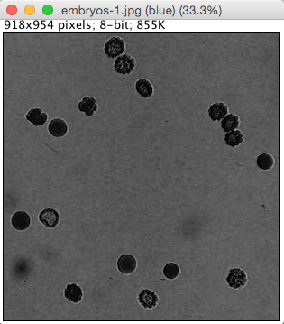
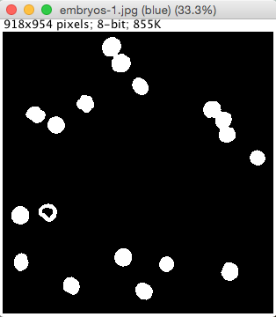
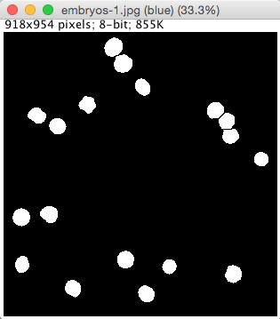
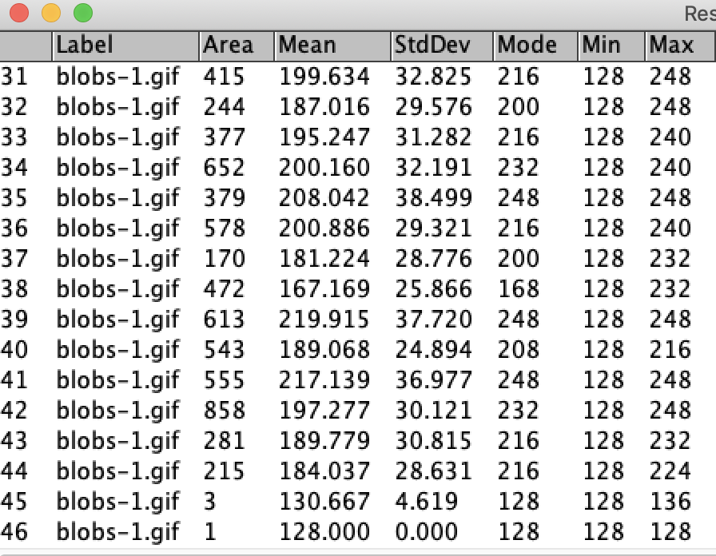
Recap: Segmentation 1
Region segmentation
Watershed: split regions
Binary image
Labels
Classic segmentation pipeline
Preprocessing
Segmentation
Postprocessing
Analysis

Slide 4


Recap: Filters
Image Filters
Morphological Operations
Image Math

Slide 5
Overview
Introduction to Machine Learning (ML)
Supervised learning
Decision trees and random forest
How to segment an image with a pixel classifier
Ilastik software
Hands-on session

Slide 6
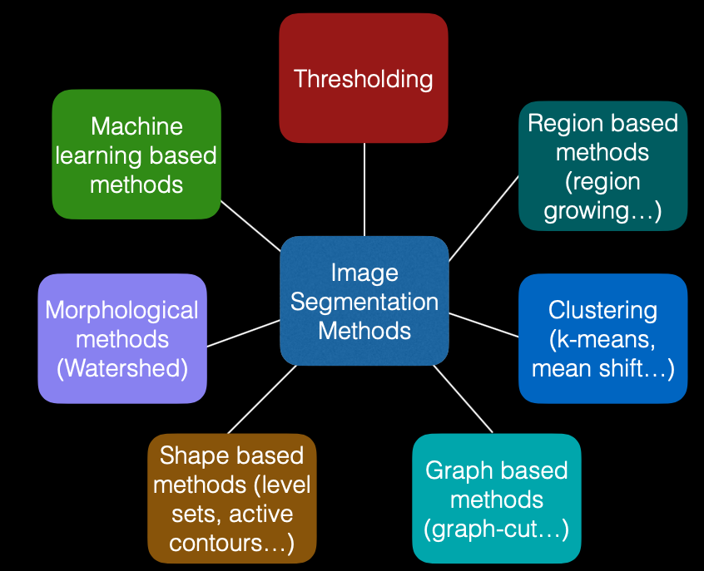
Recap: many segmentation methods
Image by: Ignacio Arganda-Carreras, Biological Image Reconstruction and Analysis Course, 2016

Slide 7
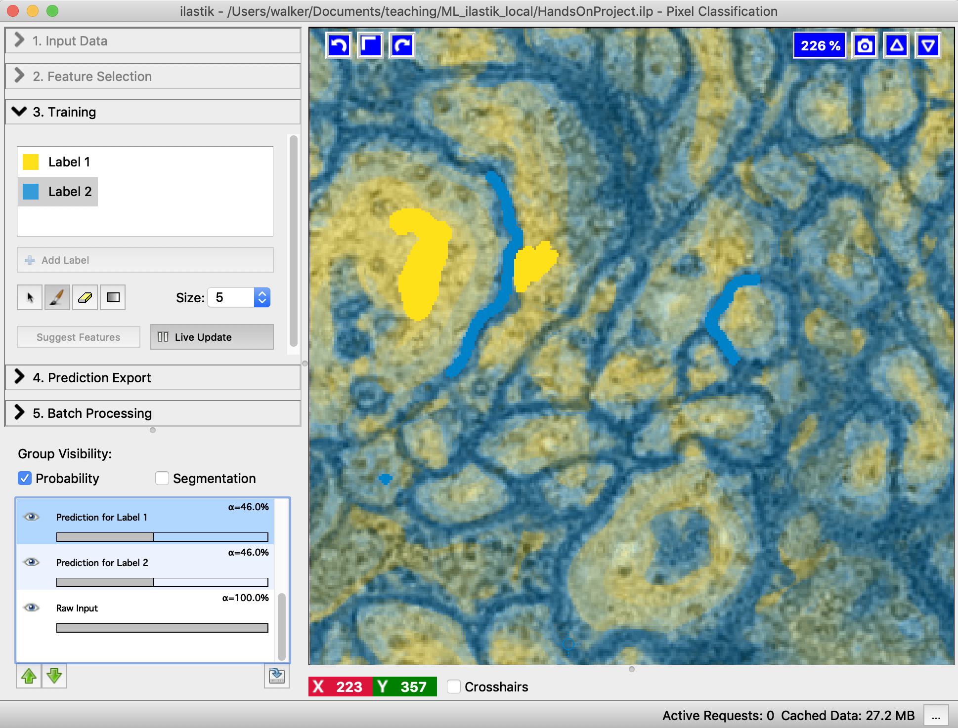
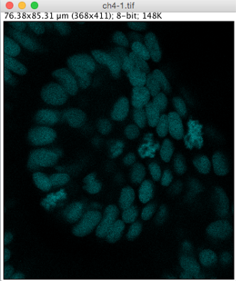

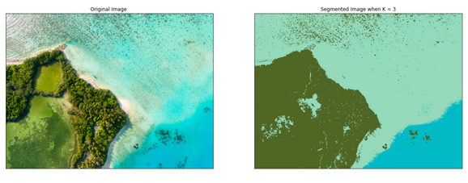
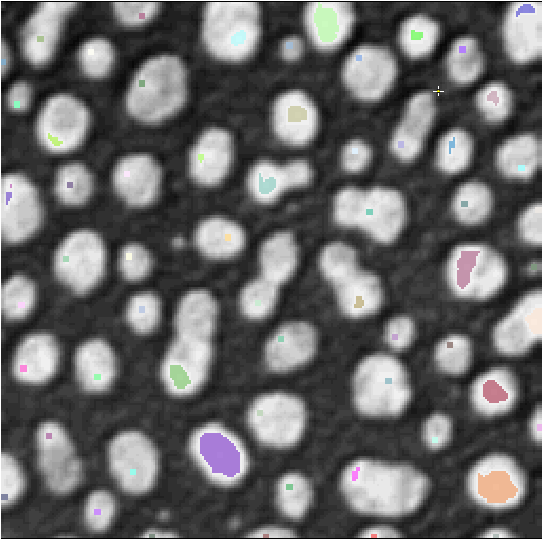
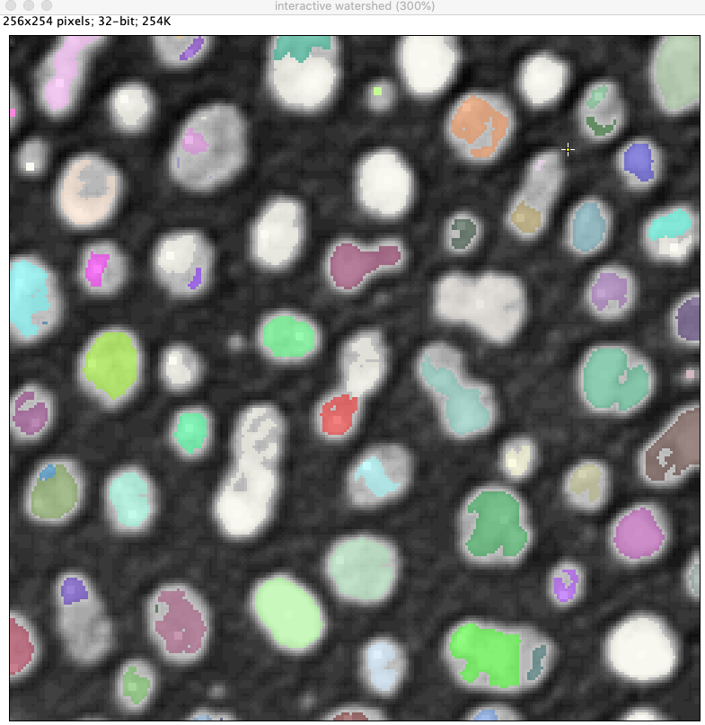
Recap: Many segmentation methods
Examples
Thresholding
Machine learning: supervised pixel classification
Unsupervised learning: Clustering
Region growing: from seed points
Image: https://morioh.com/p/dcdc9957bc1c
Notes:
Thresholding: simple but often works
Pixel classification: also quite simple to do.
Start with red in course, then gray.

Slide 8
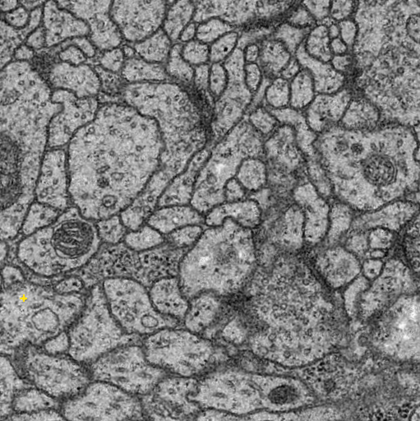
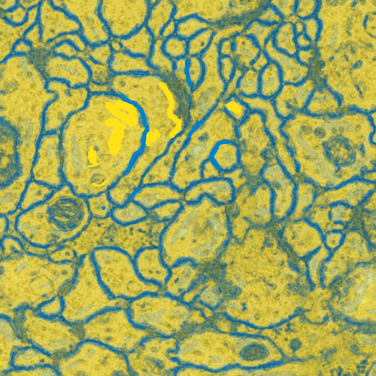
Our Goal
Segmenting an image by using pixel classification
Assign each pixel of an image a class or label
Segmentation
Assigning a label to different objects in an image
For example.: background, cell A, cell B, etc.
Image segmentation with Pixel Classification

Slide 9
Introduction to Machine Learning

Slide 10

What is machine learning?
“Field of study that gives computers the ability to learn without being explicitly programmed" (Arthur Samuel, 1959).
Some tasks difficult for us might be easy for a machine – e.g. handling big-data
Some others easy for us, difficult for machines – e.g. face recognition.
Image source: https://nudatasecurity.com/
Notes:
We can find cat pictures by asking computer to find it, but if we want to recognize a cat in a live stream video, its not so easy

Slide 11
Machine learning
Typical task:

Slide 12
Machine learning
Typical task:
Assign labels to objects indicating their class.
by a set of measurements or features.

Slide 13
Machine learning
Typical task:
Assign labels to objects indicating their class.
Objects represented by a set of measurements or features.
x₁
x₂

Slide 14
Supervised vs Unsupervised Learning
x₁
x₁
x₂
x₂
Supervised
Unsupervised

Slide 15
Supervised vs Unsupervised Learning
To which class belongs each new point?
x₁
x₁
x₂
x₂
Supervised
Unsupervised

Slide 16

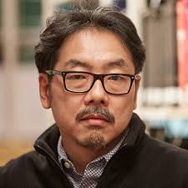
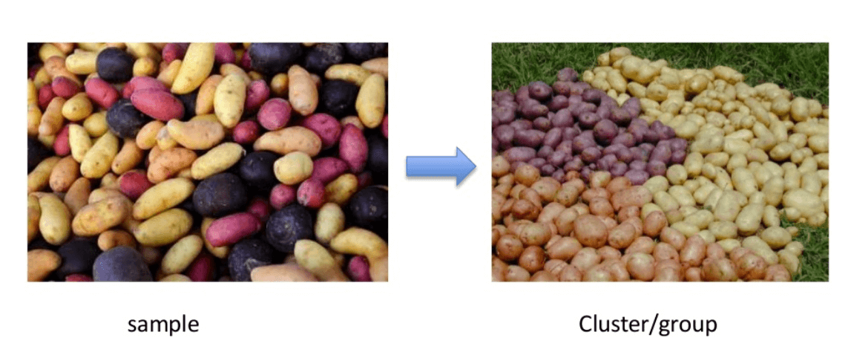
Supervised vs Unsupervised Learning
Supervised learning
Data is labeled (apple or banana?)
A classifier is trained using labeled data to later automatically identify the labels of new data
Types:
Classification – recognition of an object (apple, banana, character, digit, etc.)
Regression – estimation of a value (age, weather conditions, stocks trends, etc.)
Unsupervised learning
Data is not labeled
Uncategorized data is modelled to discover categories in them – this is called clustering
We start with: “Supervised learning”
“three”
Age: 26.7
Clustering Image source: https://www.guru99.com

Slide 17
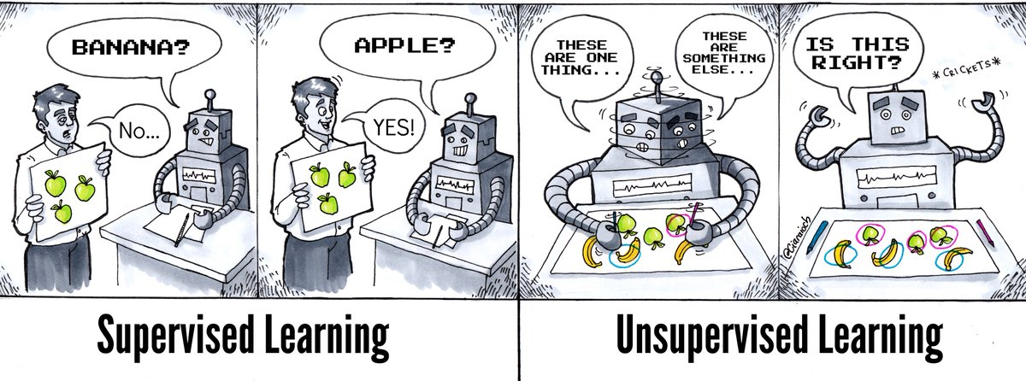
Supervised vs Unsupervised Learning
Image source: https://www.athena.ie/
Notes:
Supervised – playing flashcards with the machine, keep doing it until the machine recognizes correctly
Unsupervised: machine playing flashcards with itself – for e.g., it sees apples are green and bananas are yellow and based on this, it piles them into two groups (clustering). It can also use more criteria (features) like shape for example.

Slide 18
Quiz 1: Supervised vs Unsupervised
For the following problems which type of learning is applied?
You test a new drug on 50 patients. You measure their pulse-rate, temperature to gauge the effectiveness of the drug. You provide the measured parameters to a model. You see that the model divides the patients into two groups – Responsive and non-responsive
You have 100 cards with some text on them. You label each card text as “positive” or “negative”. Now you feed an algorithm pairs of text and label. Now, you want it to identify if a text piece from a newspaper is positive or negative. You feed this text to the the algorithm and it gives the output – “positive”.
A. Supervised
B. Unsupervised

Slide 19
Class, Features & Dataset
Class
These are output categories for the data
Each of the “labels” is a class (cell A, cell B, tumor, non-tumor, etc.)
For supervised learning these classes are predefined
Features
These are characteristics of the data
Examples:
Size, area, shape, circularity (quantitative)
Intensity, color, texture (qualitative)
Dataset
Set of samples. Each data point is called a sample
In supervised learning, a dataset consists of set of pairs - sample, class
E.g. { (cell 1, tumorous), (cell 2, tumorous), (cell 3, non-tumorous), ….}
In unsupervised learning, the dataset consists of only samples
E.g. { cell A, cell B, cell A, cell C, … }
Classes:
apple - banana
Suitable features:
color
size
shape
…

Slide 20
Quiz 2: Class or feature?
Which of the following are classes and which are features?
You measured the GFP expression level of many cells. Depending on expression level you categorize the cell as WT or mutant.
GFP expression level: feature or class?
WT/mutant: features or classes?
We want to distinguish between healthy and sick human lungs based on x-ray images. Therefore we measure lung size, symmetry, contrast,…
healthy/sick: features or classes?
Size, symmetry,..: features or classes?
A. Class
B. Feature

Slide 21
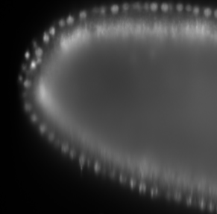

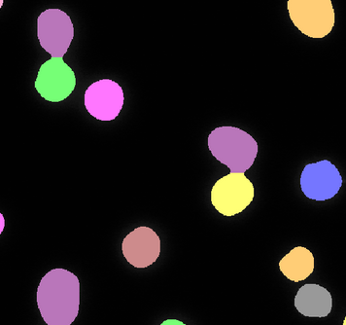
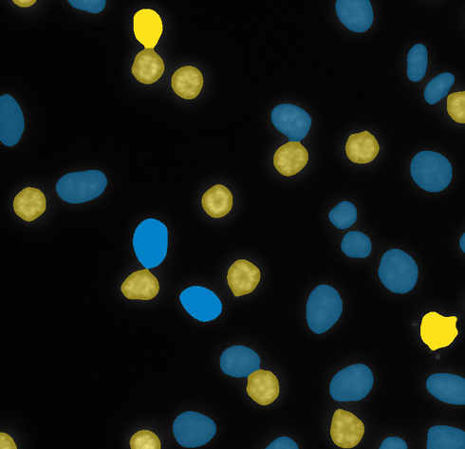
Classification in the context of images
Classification can mean different things in the context of images:
Classify each pixel – pixel based classification
Classify different objects present in an image – object based classification
class
pixel
nuclei
or
background
segmented objects
class
wild type
mutant
Image source:https://www.ilastik.org/
Notes:
A model is trained with sample + its classes
When a new sample, is presented to this model, it identifies this sample based on what it has previously learned

Slide 22
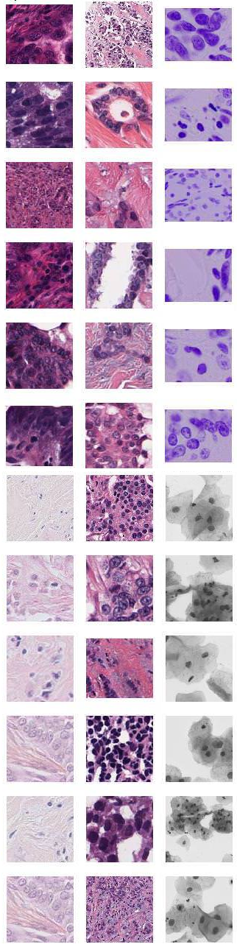
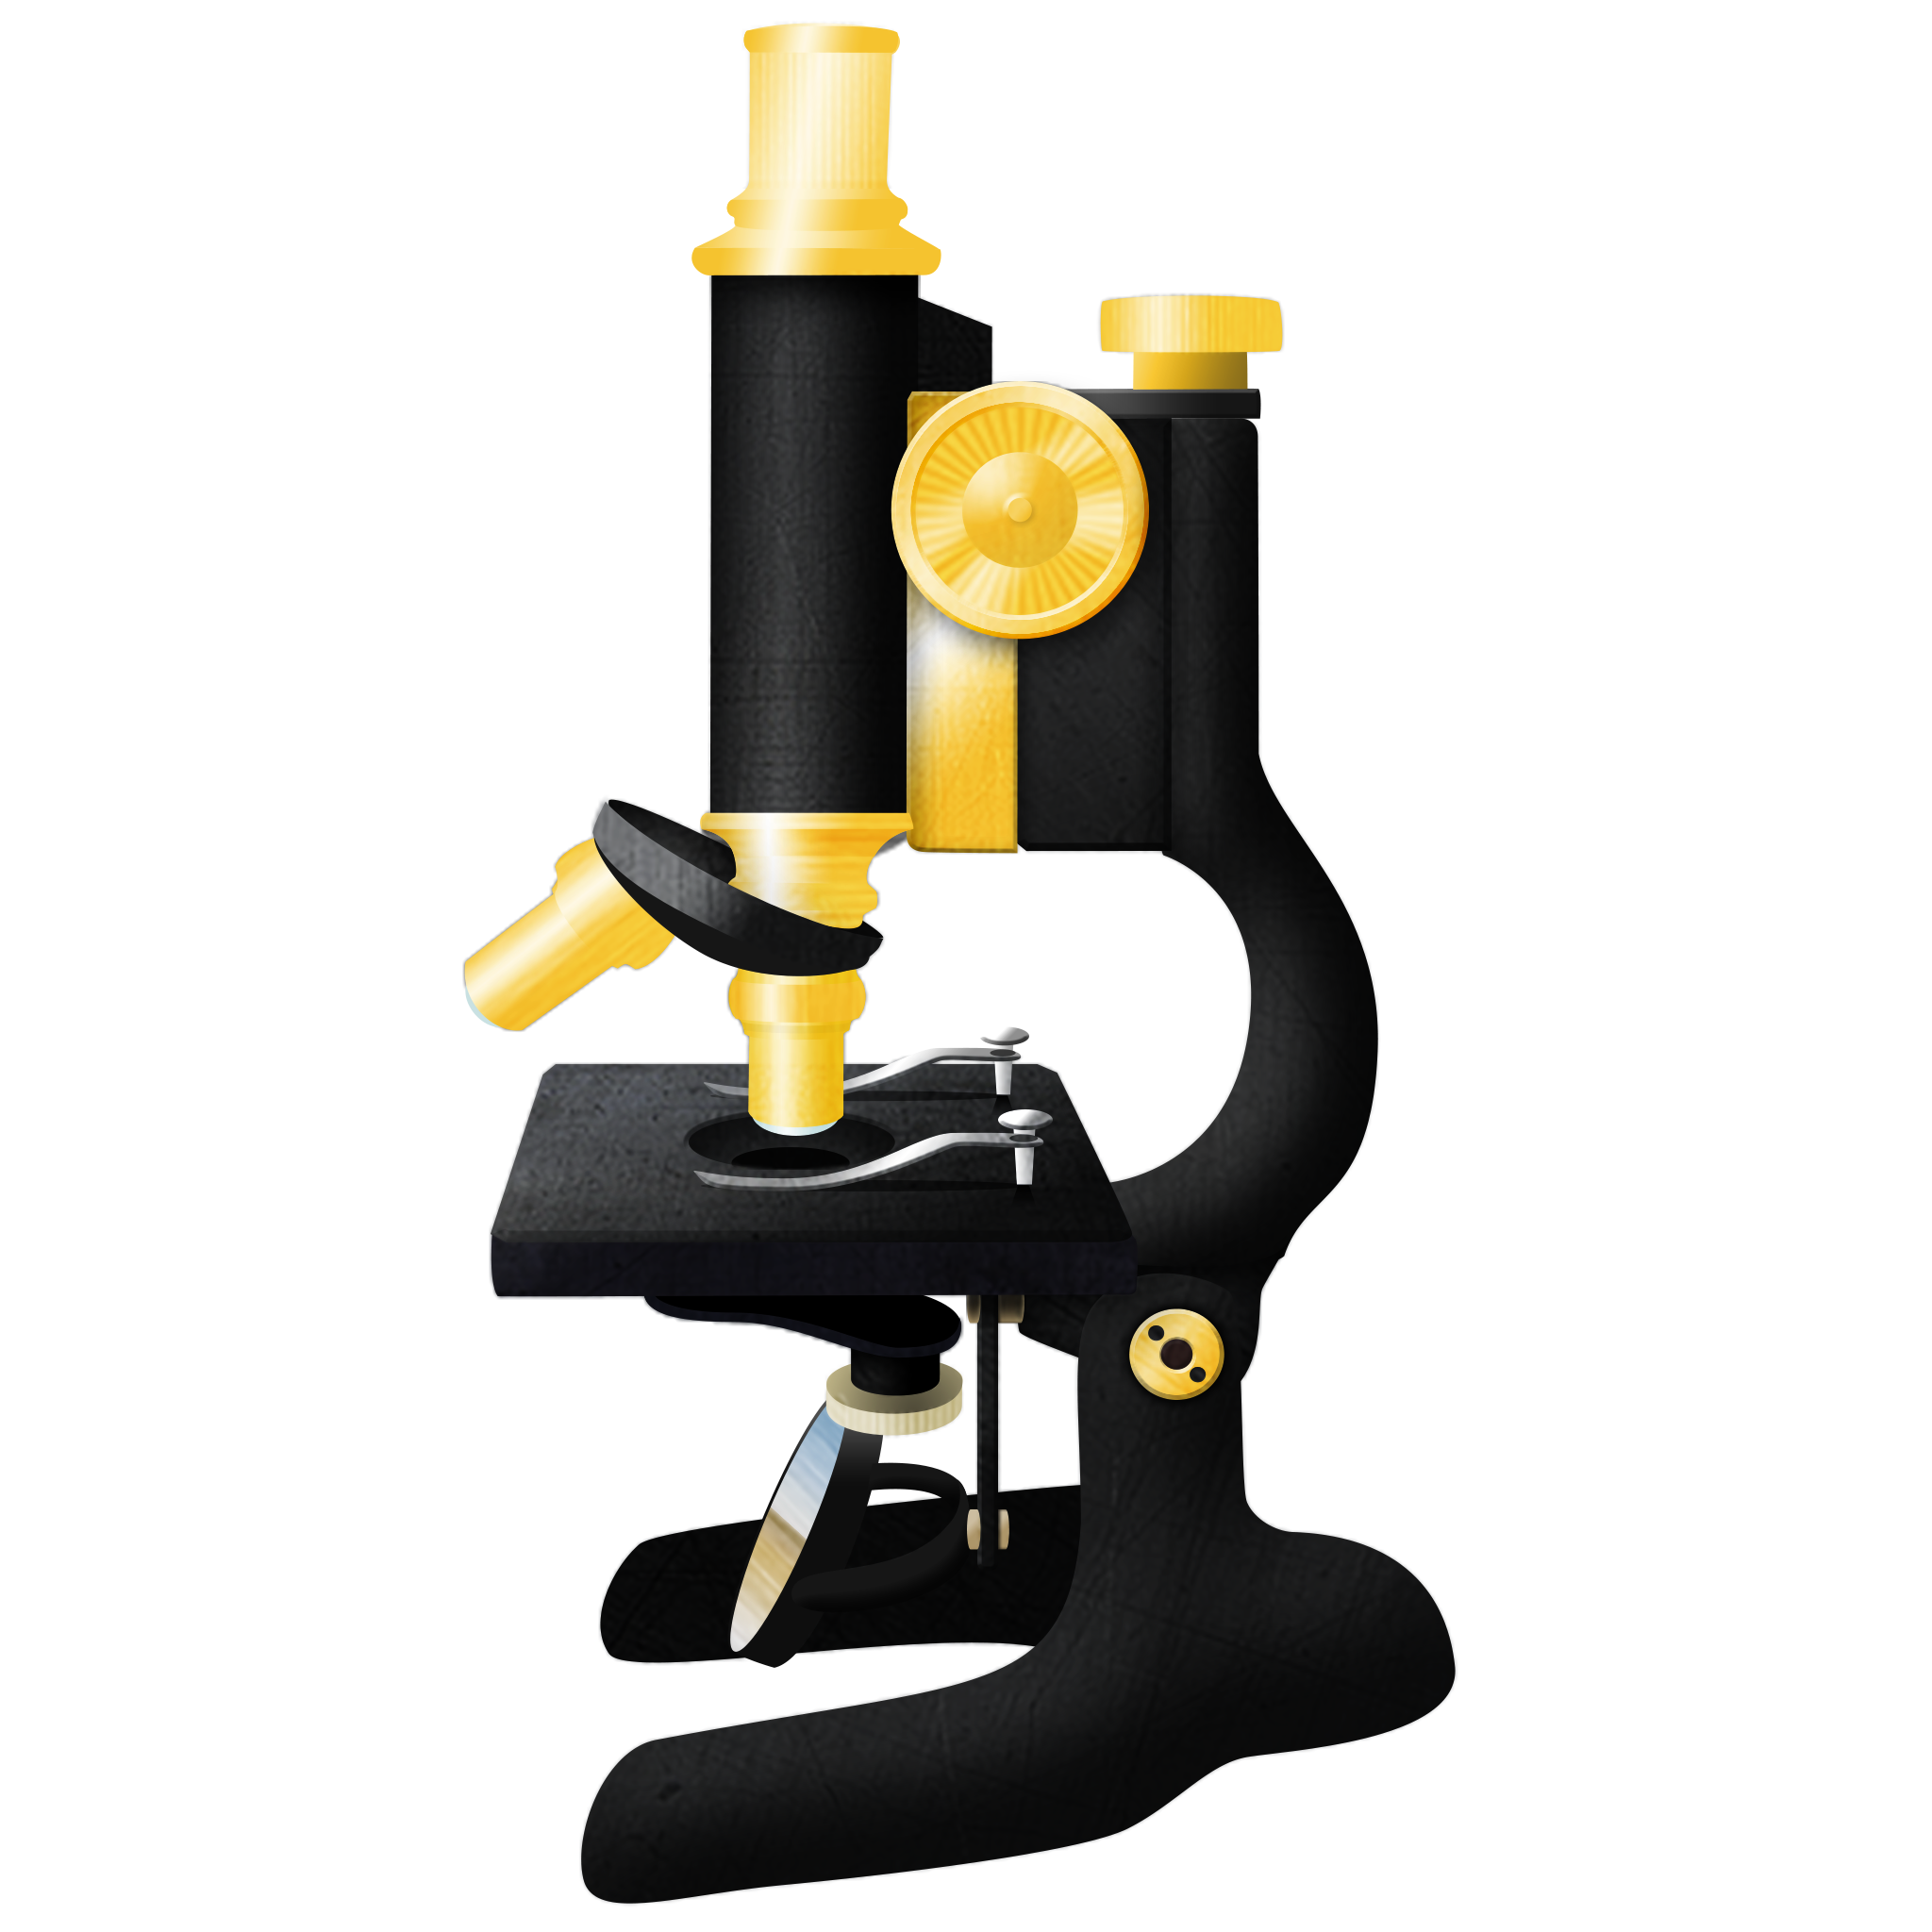

Classifier Design Cycle
Designing and training a classifier is an iterative process.
1.3
0.4
5.2
5.9
2.3
0.3
0
0.8
1.9
2.4
7.4
Supervised learning example
Real
world
Feature
selection
Model
selection
Training
Test
Data
collection
No
Valid result?
Yes
Back to real world
Pre-processing,
Label data manually (create ground truth),
Extract features
Notes:
This cycle corresponds to supervised learning

Slide 23
Testing & Evaluation
Good practice: not to use all the data you have, to train a model
Causes “overfitting”
How to divide the samples? For example:
Train: to build the model (~66% of samples)
Test: to evaluate the model (~33% of samples)
Evaluation (short version):
Measure correct / missed / wrong predictions for each class.
Data
Train |  | Test
learning algorithm
classifier
prediction

Slide 24
Classifier Evaluation in detail
How do we evaluate the performance of a classifier?
How do we compare classifiers?
Confusion matrix:
Example metrics:
Sensitivity or True Positive Rate: TP/ P
Accuracy: (TP + TN )/ No
TP: True Positive, TN: True Negative, FP: False Positive, FN: False Negative,
No: Total samples, P: Total positive samples, N: Total Negative samples
 |  | Prediction
 |  | u₀ | u₁
Real class | u₀ | TP | FN
 | u₁ | FP | TN
⇐ Predicted labels
No = P + N
P = TP + FN
Ground truth ⇒
N = TN + FP
Notes:
To measure how well does the output correspond to the expected result
Sensitivity- When it's actually yes, how often does it predict yes?
Accuracy- overall how often is the model correct?

Slide 25
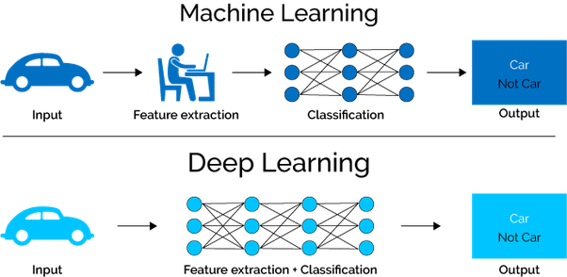
Shallow vs Deep Learning
Shallow Machine learning
Random Forest, SVN, etc.
Fewer parameters in the model
Little labelled data required
Easier to train
Features hand-engineered
Deep learning
Neural networks
Very many parameters
A lot of labelled data required
More powerful & more work
This session:
Shallow Learning
Image source: https://mc.ai/machine-learning-vs-deep-learning-5/

Slide 26
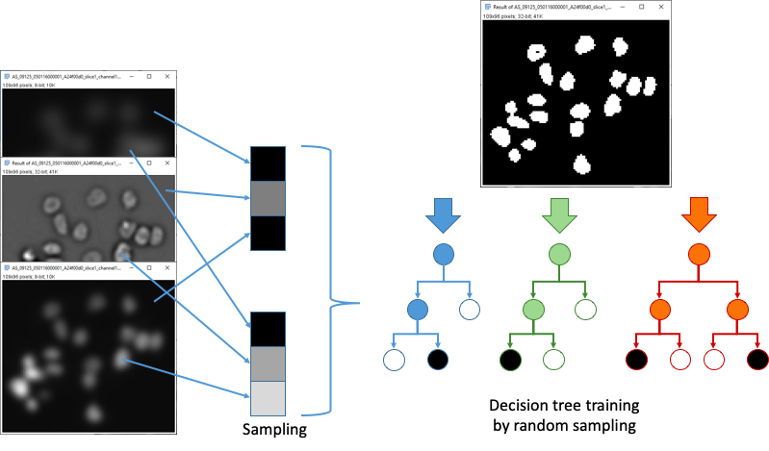
Supervised Learning
with
Decision Trees
and
Random Forest

Slide 27
Supervised learning algorithms
Recap supervised learning:
Input data is labelled.
An algorithm is trained to predict the labels (classes) based on the data features.
The algorithm is then applied to new data to predict their labels.
A lot of algorithms for supervised learning exist:
Support Vector Machines
Decision trees / Random forest
Naïve Bayes
…
Image source:https://www.scikit-learn.org/
Notes:
Example: we have segmented data, want to segment new data

Slide 28
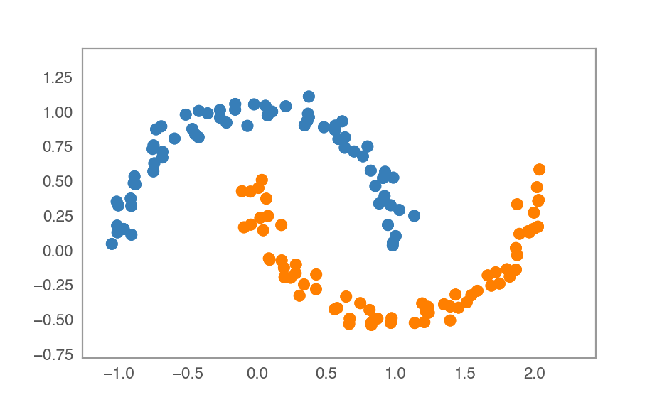


Decision trees
Features
2D coordinates of points
Targets:
“good” (class 1)
“bad” (class 0)
https://scikit-learn.org/
Slide courtesy: Martin Weigert, EPFL Lausanne
@martweig

Slide 29
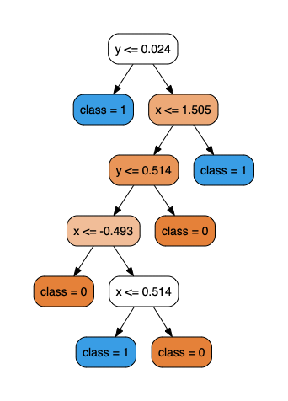
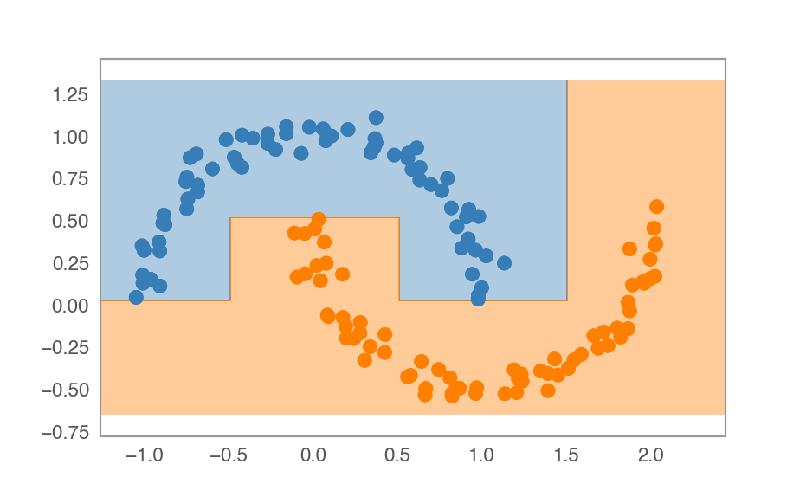
Decision trees
“good” (class 1)
“bad” (class 0)
New point
https://scikit-learn.org/
Slide courtesy: Martin Weigert, EPFL Lausanne
@martweig

Slide 30
Decision trees
https://scikit-learn.org/
Slide courtesy: Martin Weigert, EPFL Lausanne
@martweig

Slide 31
Decision trees
https://scikit-learn.org/
Slide courtesy: Martin Weigert, EPFL Lausanne
@martweig

Slide 32
Decision trees
https://scikit-learn.org/
Slide courtesy: Martin Weigert, EPFL Lausanne
@martweig

Slide 33
Decision trees
https://scikit-learn.org/
Slide courtesy: Martin Weigert, EPFL Lausanne
@martweig

Slide 34
Decision trees
https://scikit-learn.org/
Slide courtesy: Martin Weigert, EPFL Lausanne
@martweig

Slide 35
Decision trees
https://scikit-learn.org/
Slide courtesy: Martin Weigert, EPFL Lausanne
@martweig

Slide 36
Decision trees
https://scikit-learn.org/
Slide courtesy: Martin Weigert, EPFL Lausanne
@martweig

Slide 37
Random Forest
Random forest is an ensemble of many random decision trees.
Each of the trees uses a subset of the features for classification.
Purpose: more robust
Default classifier used in many tools (Ilastik, Weka, …)
Figure from Robert Haase, MPI-CBG
Notes:
Instead of a single decision tree we have many shorter trees

Slide 38
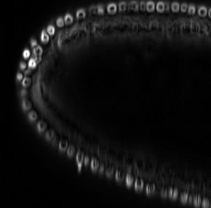
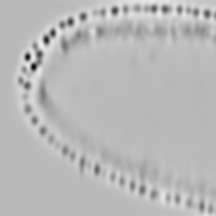
Pixel Classification with Random Forests
Image
features
Single pixel
feature list
Classify each pixel
with random forest
Intensity
nuclei
or
background
Gradient,
Edges
Texture:
“Blobiness”,
Variance, …
…
Notes:
How to segment an image with pixel classification

Slide 39
ML tools for pixel classification

Slide 40
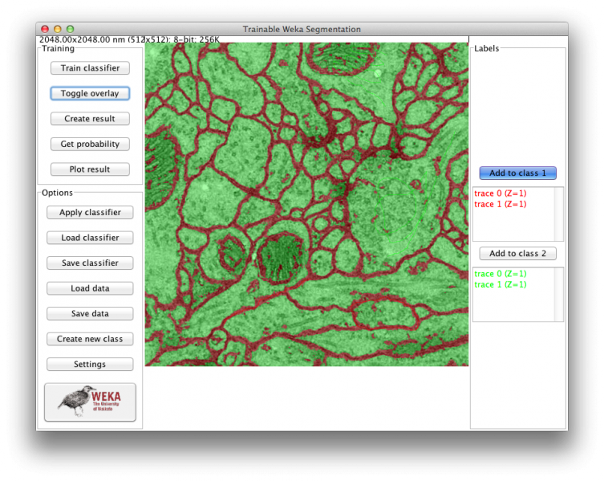
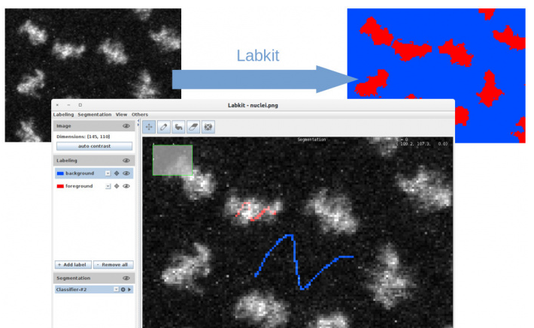

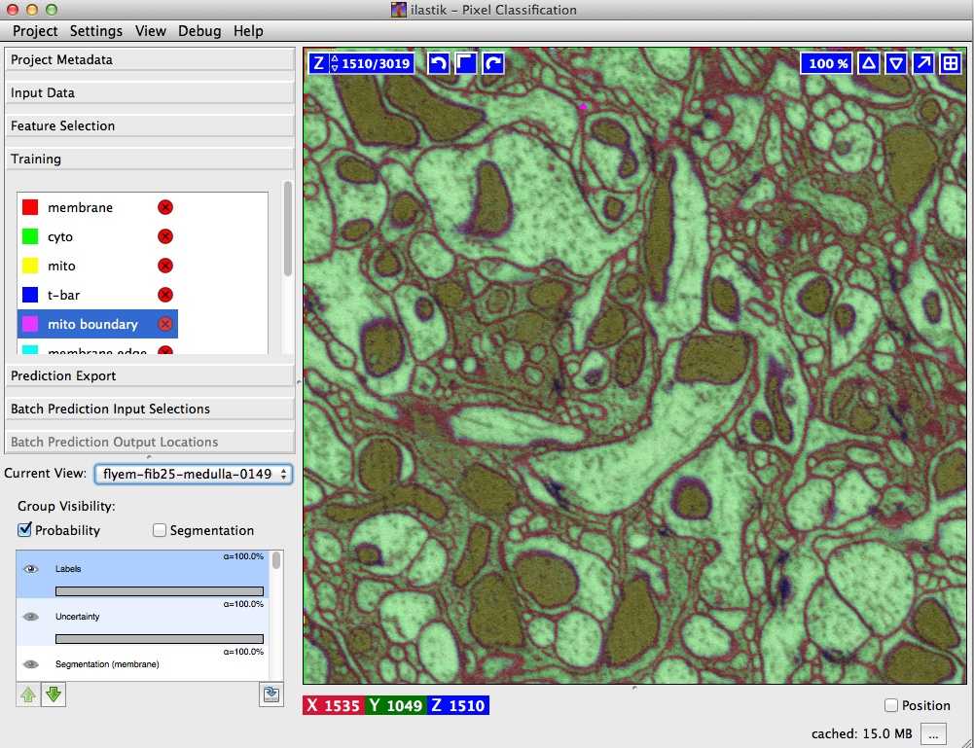

Tools for pixel classification
Trainable Weka Segmentation
Ignacio Arganda-Carreras
Fiji plugin
Labkit
Matthias Arzt, CBG
Fiji plugin
Ilastik
Anna Kreshuk lab, EMBL
Stand-alone tool
Our choice for today
Notes:
Weka: part of Fiji, data must fit into memory
Labkit: part of Fiji, for big data
Ilastik: intuitive and quite fast, good preview, also bigger data

Slide 41
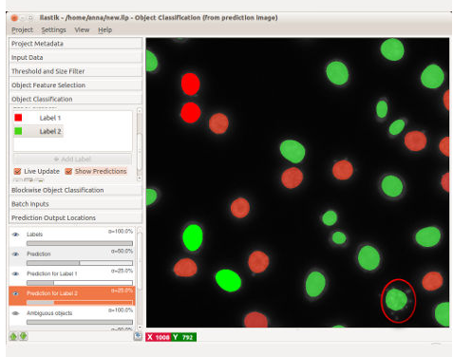
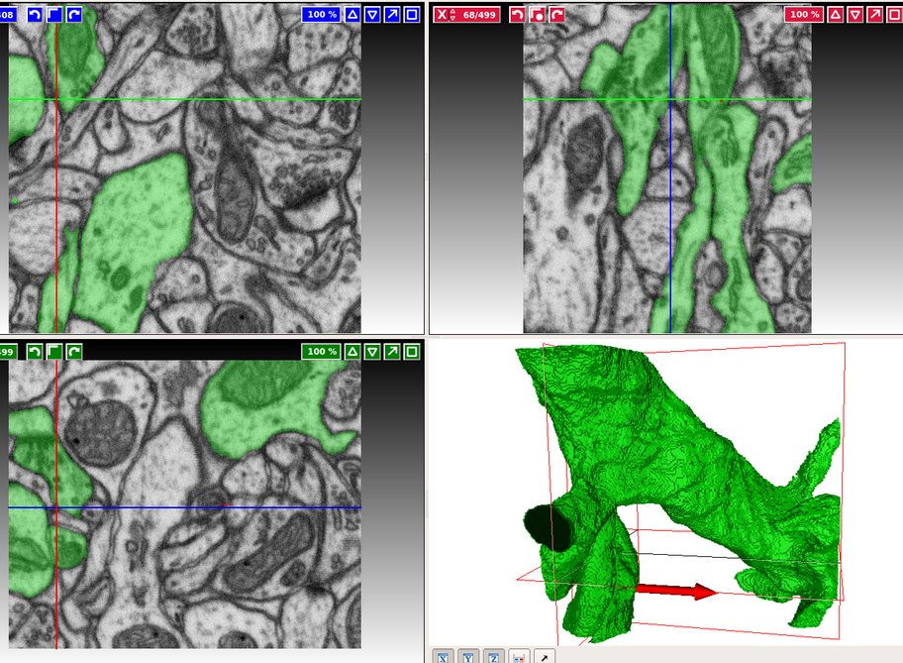
What is Ilastik
Machine learning algorithm for image analysis tasks
Interactive & intuitive
Well documented
What it can do:
Pixel classification
Object classification
Tracking
Density counting
Semi-manual 3D carving
www.ilastik.org
Notes:
Images Top to bottom:
Pixel classification
Object classification (each object belongs to a class – e.g. class 1: expresses xxx protein, class 2: doesn’t express xxx protein
3D carving: good for single complex objects

Slide 42
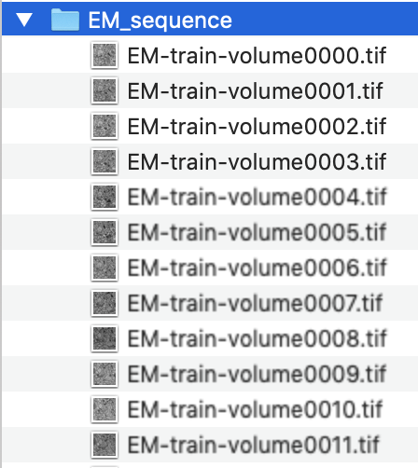
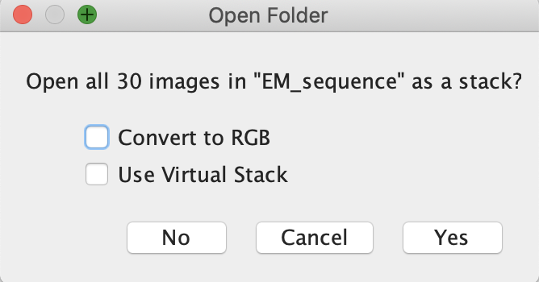
Hands-on: EM_sequence
Drosophila Embryo (TEM)
Sequence of TEM slices
Visualize the data:
Open Fiji.
Drag the EM_sequence folder into Fiji status bar.
Press Yes in ‘Open Folder’ popup.
See also Step by step HowTo guides: https://mpicbg-scicomp.github.io/ipf_howtoguides/

Slide 43
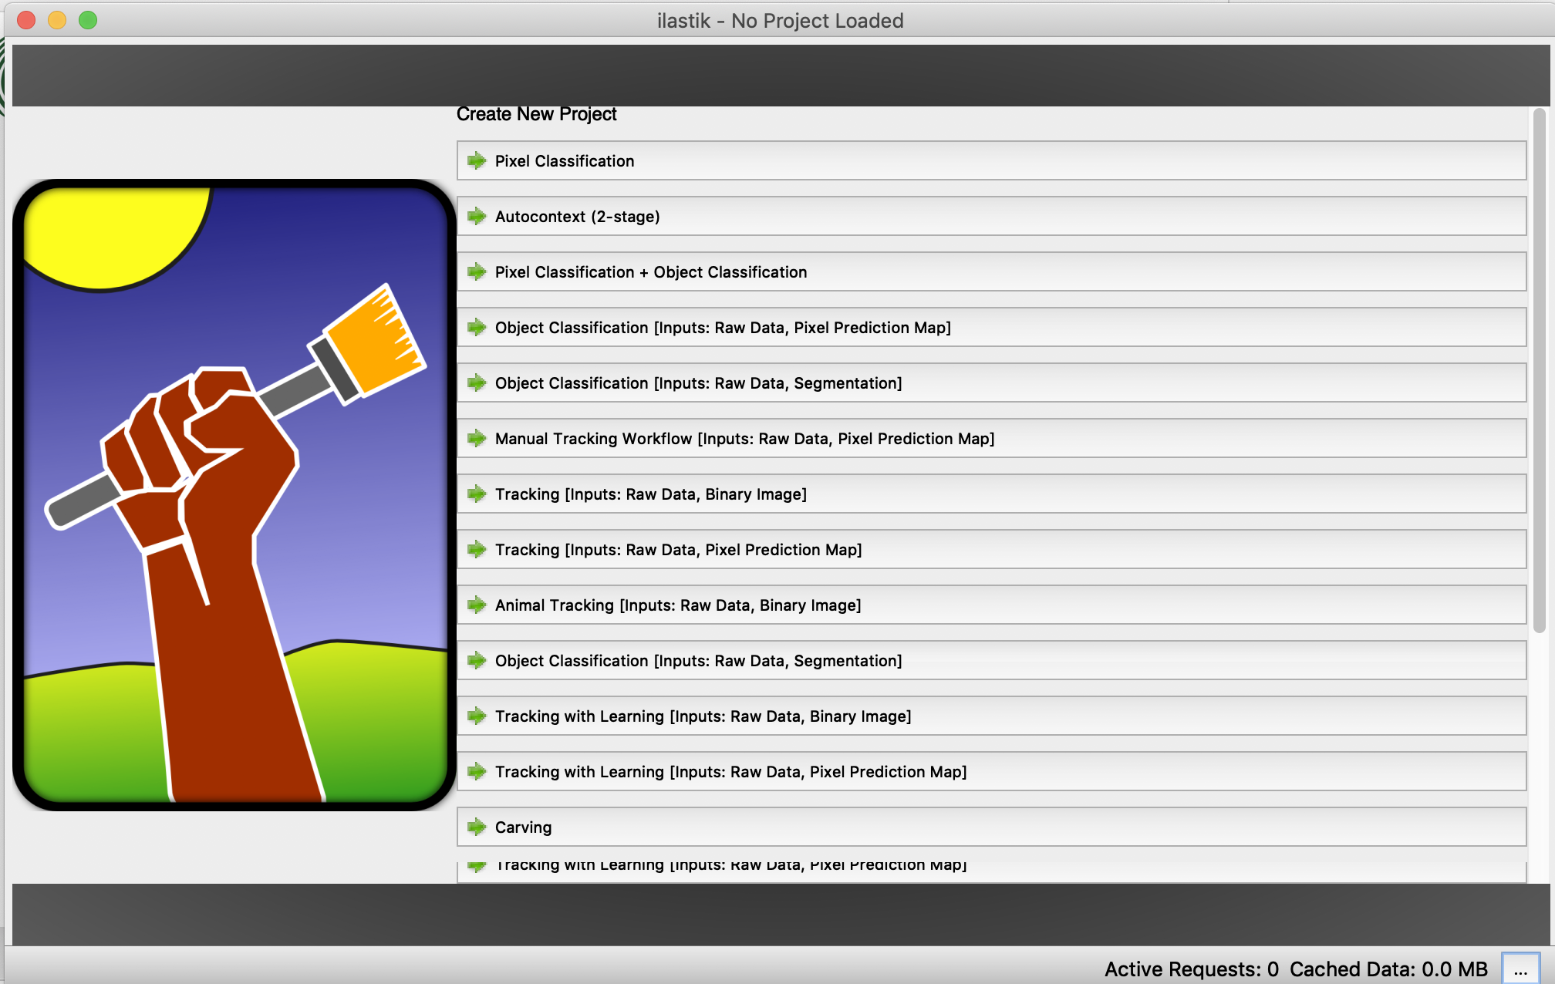
Hands-on
Open Ilastik.
Select: Create New Project > Pixel Classification.
Save the project.
Resources:
https://www.ilastik.org/documentation/index.html (ilastik documentation)
https://zmb.dozuki.com/Guide/Ilastik+Pixel+Classification+and+Segmentation/41 (step-by-step)
Notes:
If users (MacOSX) never opened Ilastik before: won’t open due to ‘unknown source’
Go to the Ilastik folder, right click -> Open
Press open in popup (unidentified developer)

Slide 44
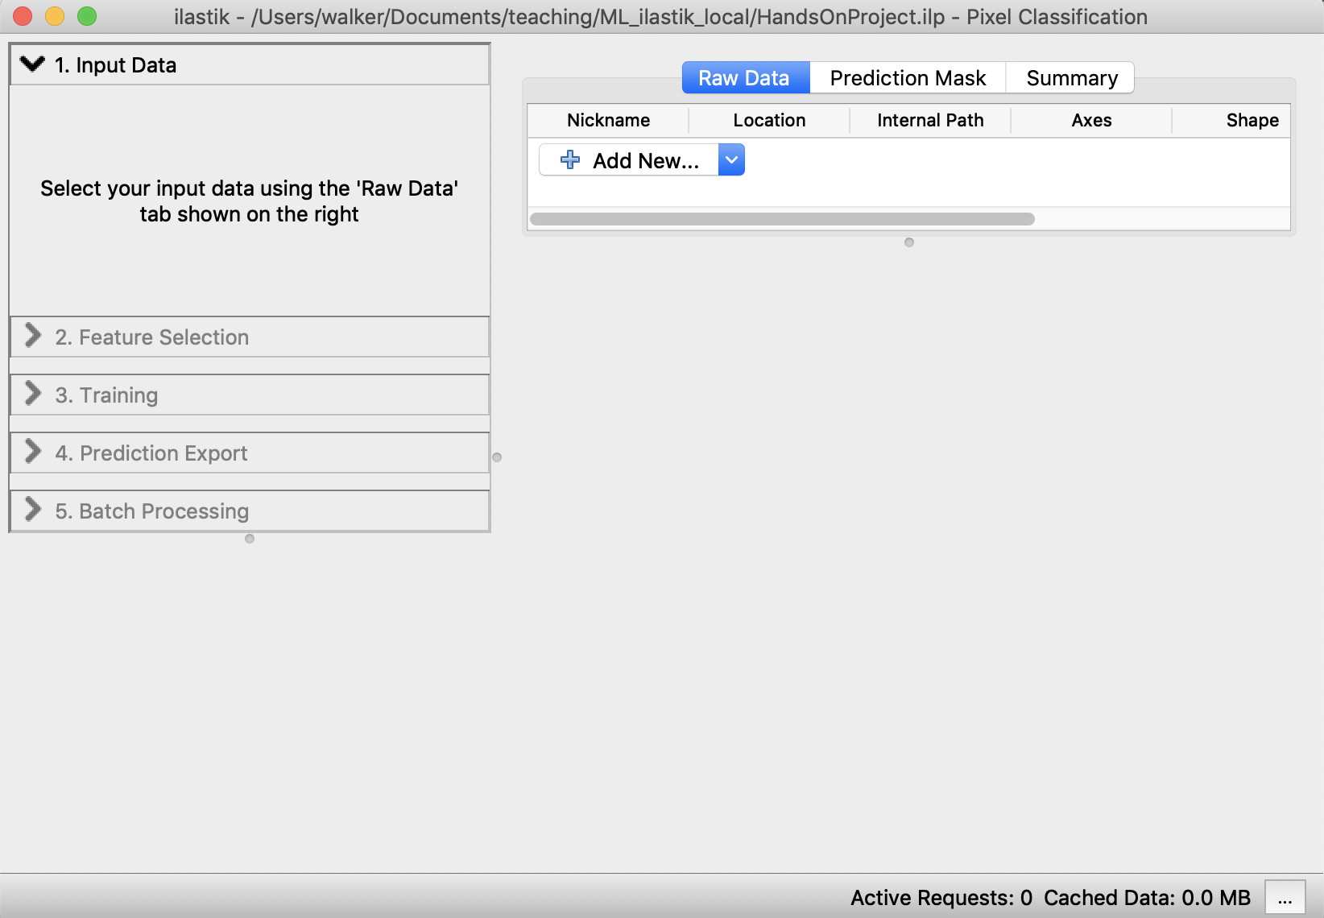
Hands-on
Define Input data:
Drag & drop an image into the white area.
or select: Add New … > Add separate Image(s)… .
We only use one image here but one can add more images for training.

Slide 45
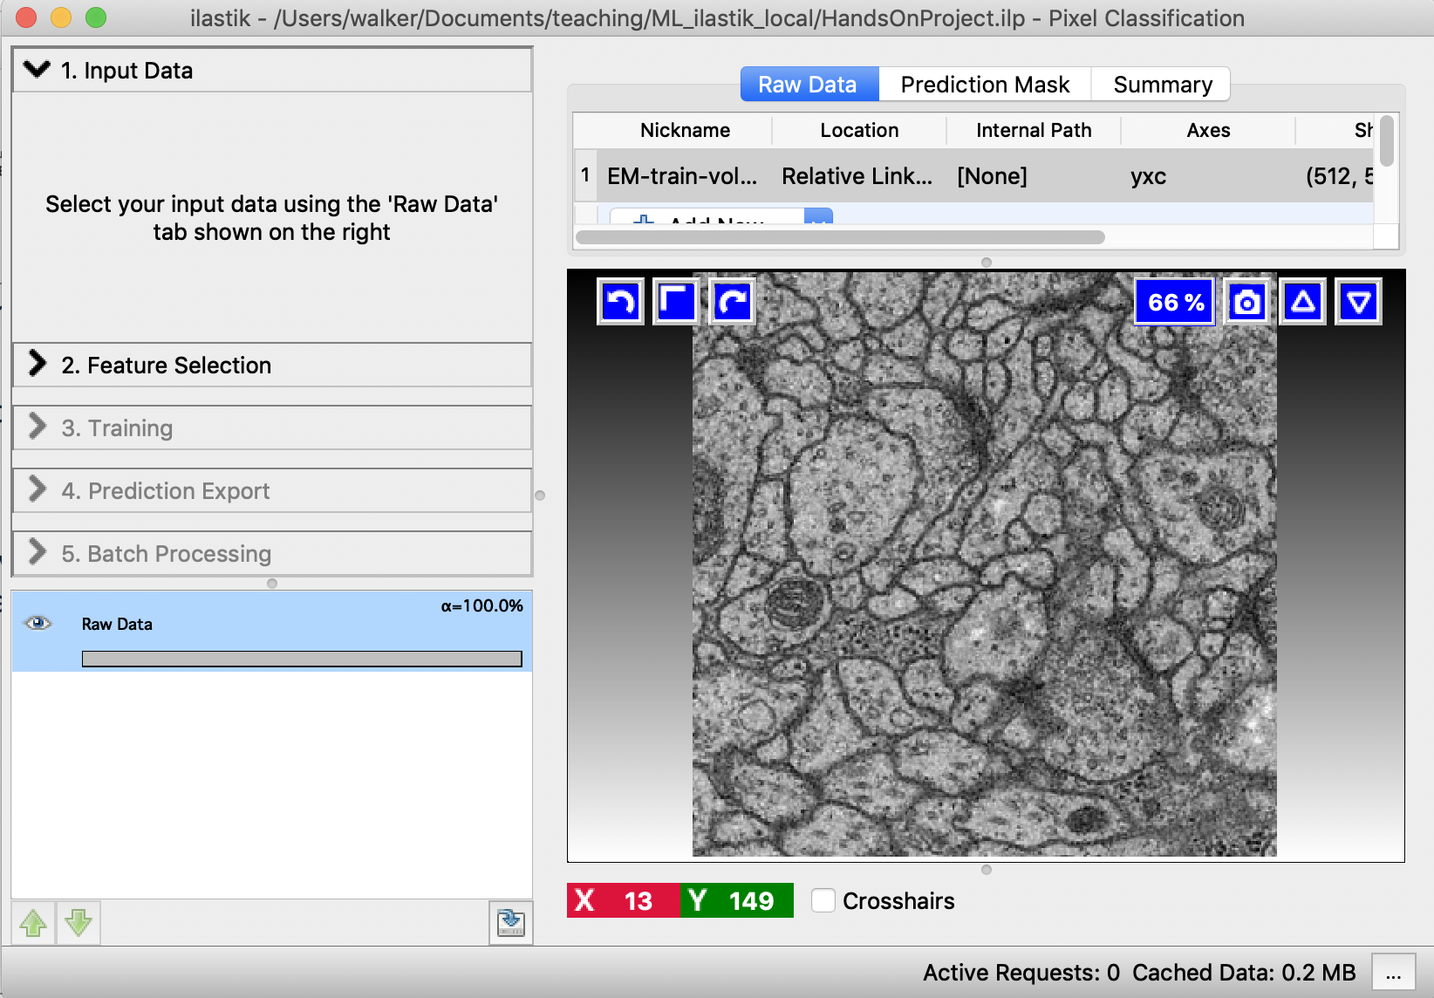
Hands-on
Define Input data:
Drag & drop an image into the white area.
or select: Add New … > Add separate Image(s)… .
We only use one image here but one can add more images for training.

Slide 46
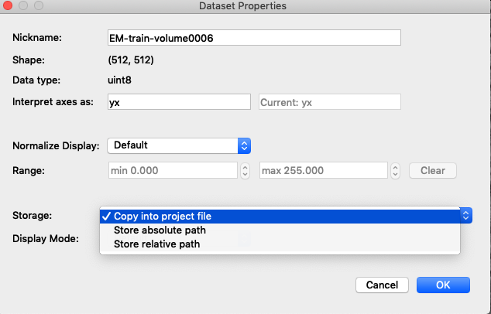
Hands-on
Copy the image into your Ilastik project.
Double click the line with the image to open the properties window.
If your images are big don’t do this. But instead make sure that you keep your train images close to the project location.
Notes:
Copying the image requires more memory but then we don’t have to worry about moving the data or project around.

Slide 47
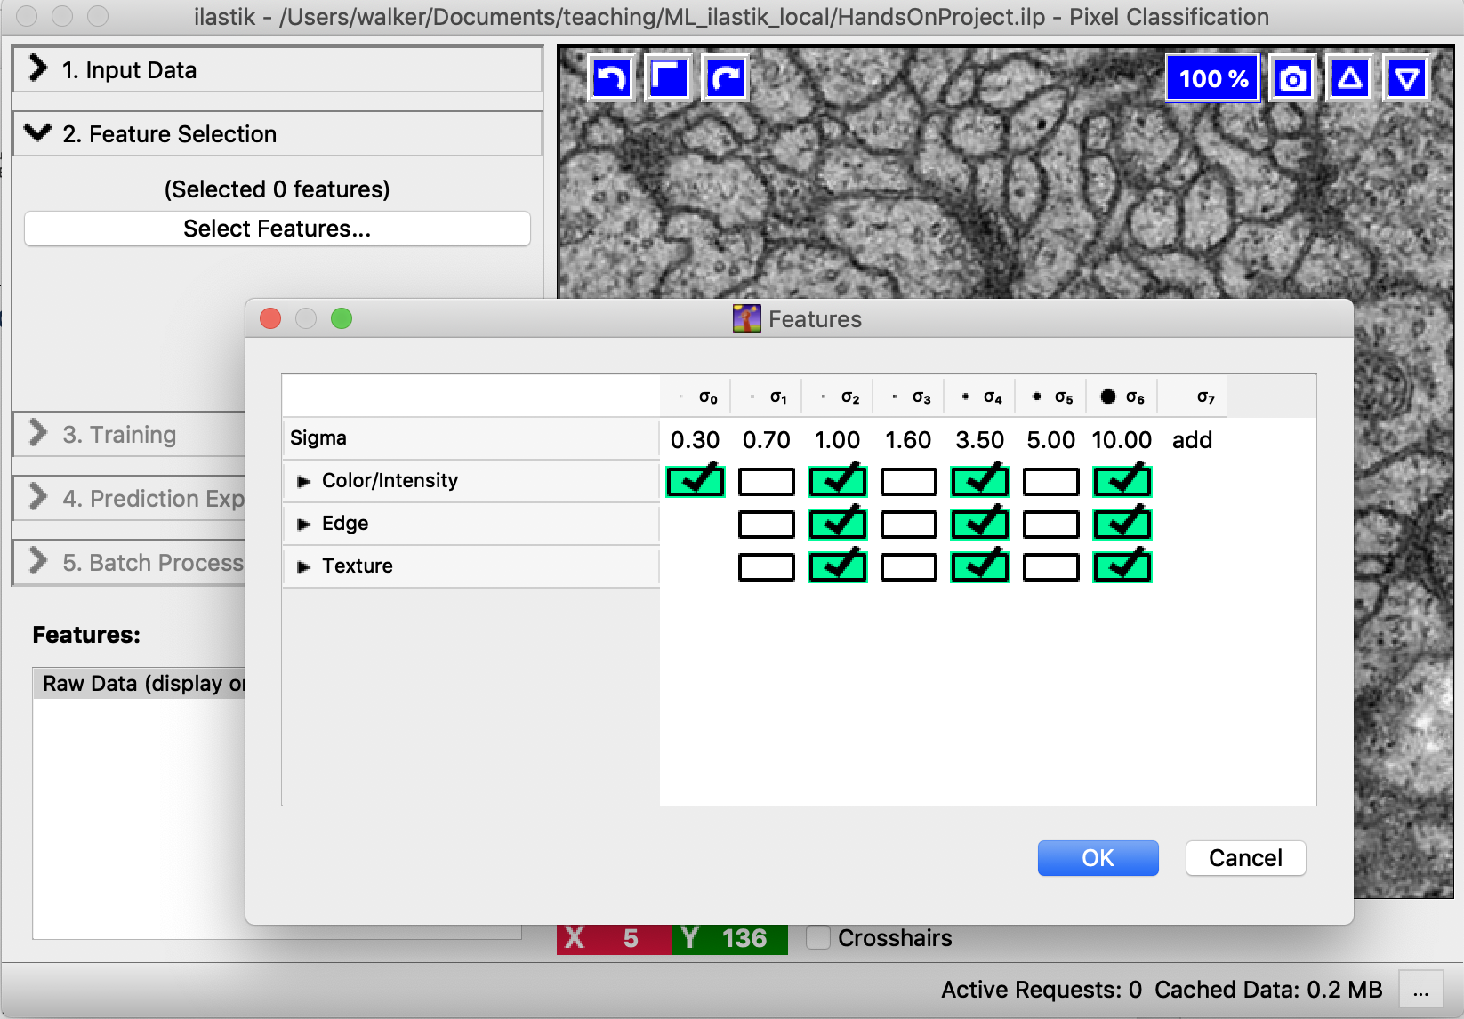
Hands-on
Select Feature Selection tab.
Click Select Features.
Select a subset of features.
The choice is initially a bit arbitrary and can be refined later.
Notes:
* More features: computationally more expensive
* Higher sigma: captures bigger structures, and computationally more expensive

Slide 48
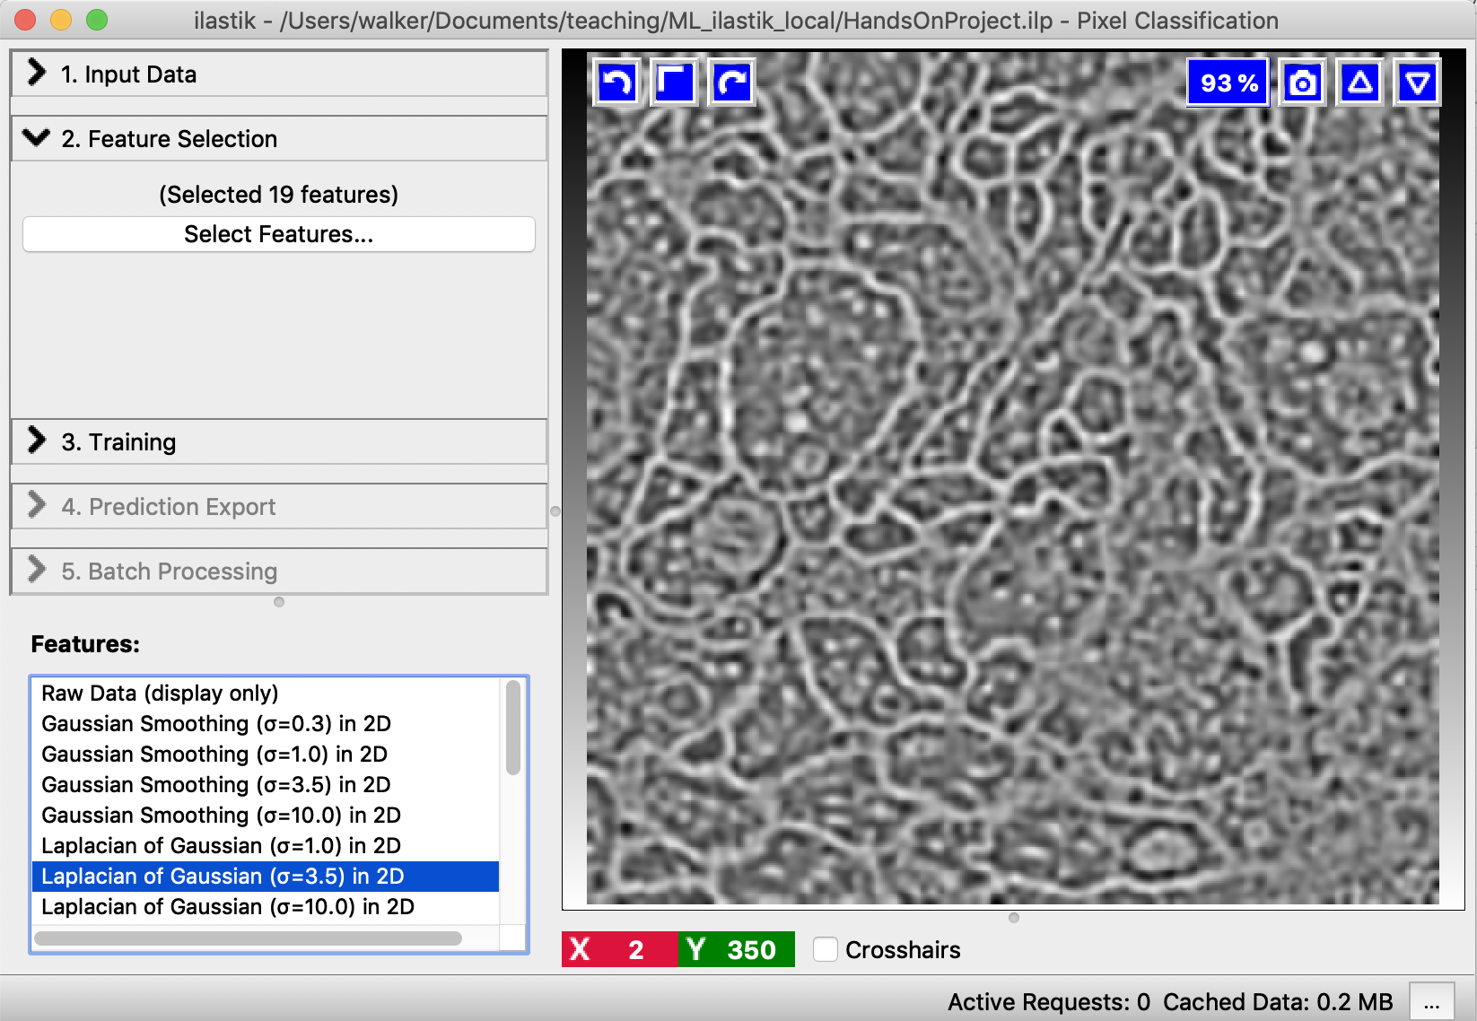
Hands-on
Optional
Visualize the features .
Visualization can indicate which features are useful.
Notes:
We see that Sigma=10 is not so useful.

Slide 49
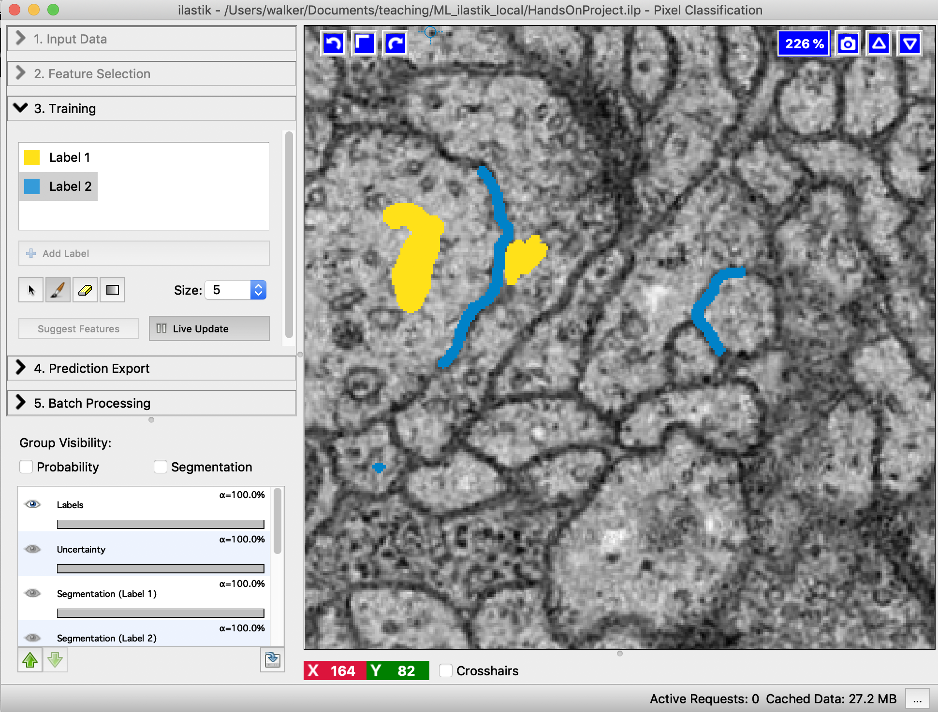
Hands-on
Select Training tab.
Zoom in, and paint some soma and membrane regions with Label1 and Label2 color.
Navigation:
Mouse:
Zoom: Cmd/Ctrl+wheel
Pan: Shift + left button
Keyboard:
Zoom: +/-
Pan: arrows keys
Notes:
Can switch between pen and eraser

Slide 50
Hands-on
Start training by pressing Live Update.
The classifier trains based on your labelled regions and shows the predictions as overlay.
Double-click on the label to change their name.
If needed, change brightness & contrast here (right click to reset) or right-click on the image in group visibility Tab > Adjust thresholds.
Group Visibility tab:
Switch between probability and segmentation.
Change transparency.
…
Notes:
Suggest features: (active when Live Update is deselected): Can propose a set of useful features.

Slide 51
Hands-on
If prediction is not good, paint more regions (increase the number of training pixels).
If preview is slow, uncheck Live Update while drawing.
Notes:
Suggest features: (active when Live Update is deselected): Can propose a set of useful features.

Slide 52
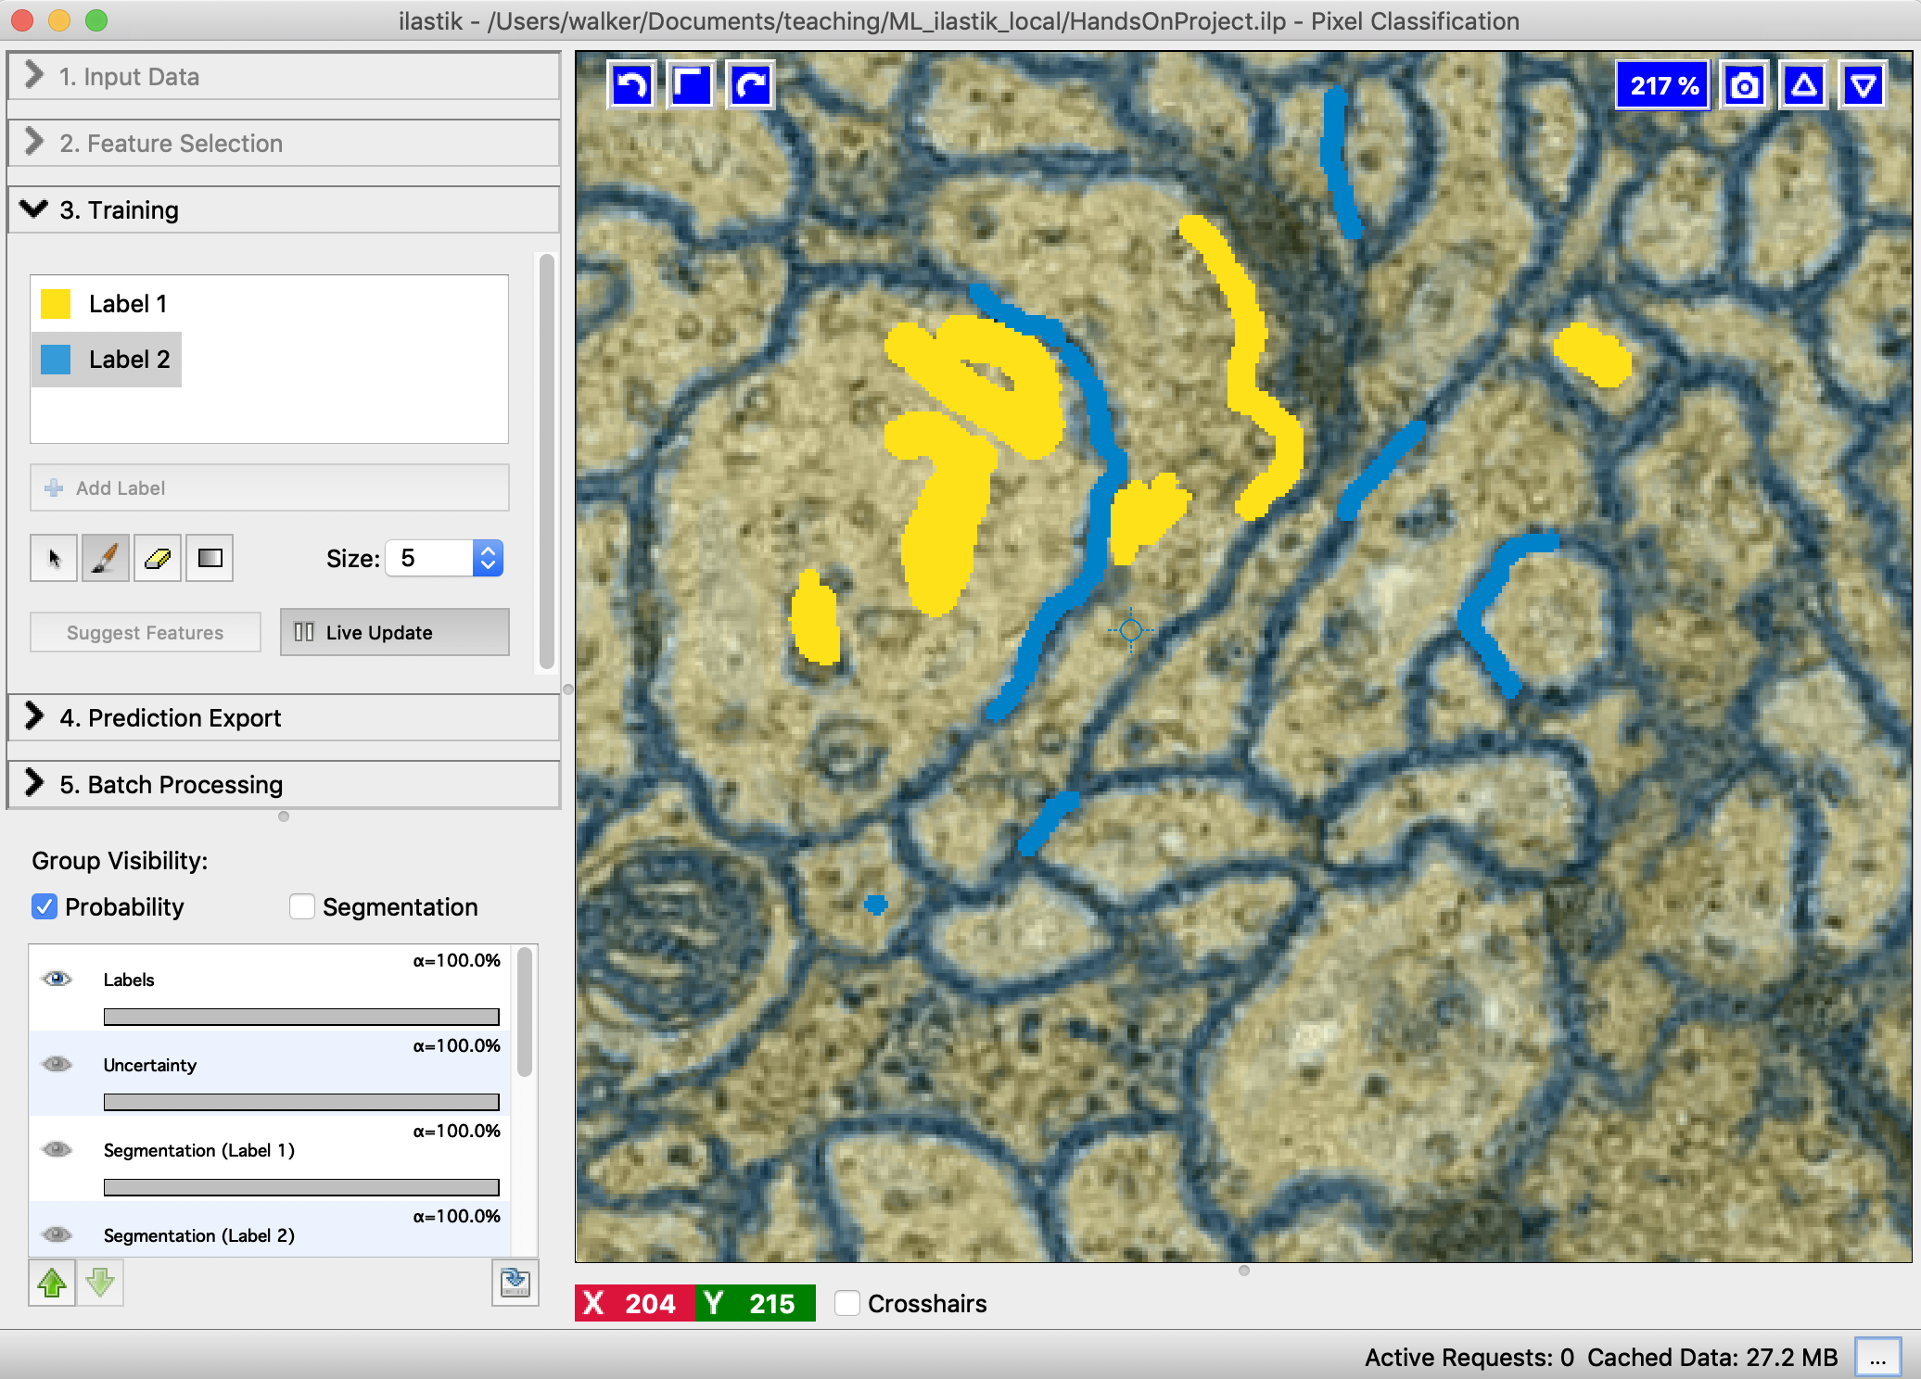
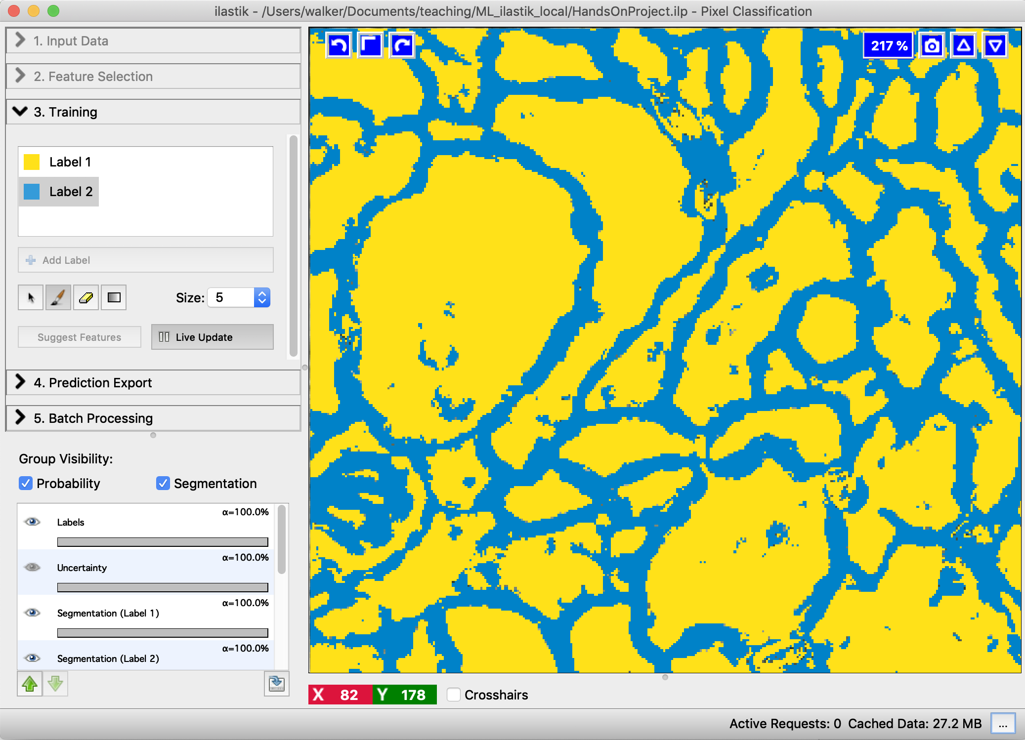
Hands-on
Check the prediction after labelling more regions.
Segmentation preview

Slide 53
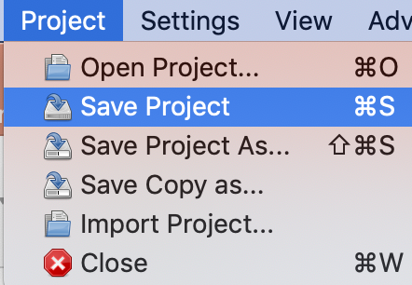
Hands-on
Save your project once in a while.

Slide 54
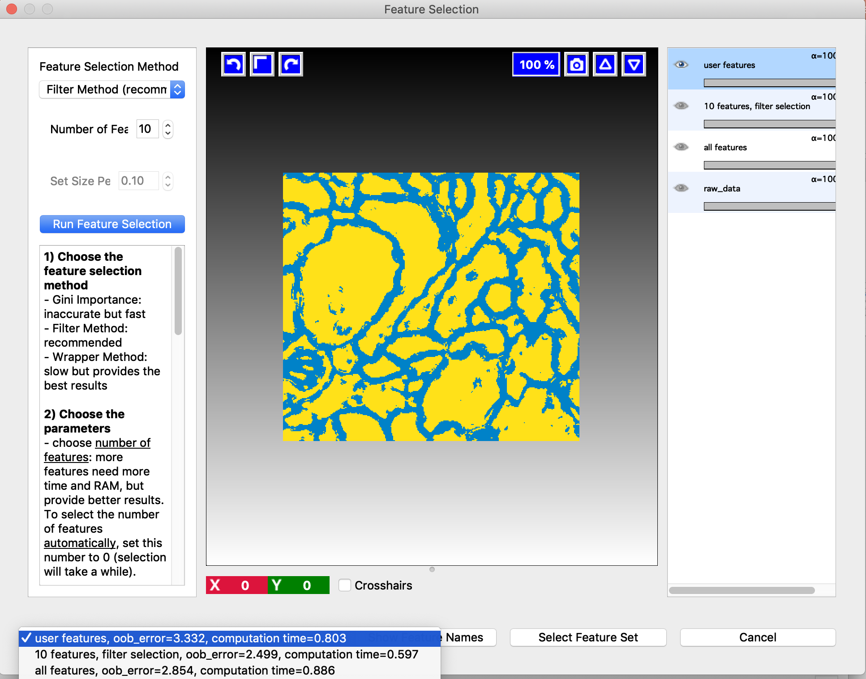

Hands-on
Optional
Still not good? Have a look at your features.
Select Suggest features. (uncheck Live Update)
Compare the predictions and choose the best feature set.

Slide 55

Hands-on
Optional
The uncertainty layer can also give you an indication which extra regions are good to label.

Slide 56

Hands-on
Select Prediction Export tab.

Slide 57

Hands-on
Select Prediction Export tab.
We can export Probabilities, Simple Segmentation and more.
Start with selecting Source: Simple Segmentation.
Click: Choose export image settings…
In a real world scenario it’s usually better to export the probabilities (contains most information).

Slide 58

Hands-on
Select Prediction Export tab.
We can export Probabilities, Simple Segmentation and more.
Start with selecting Source: Simple Segmentation.
Click: Choose export image settings…
Format: tif
File: optionally add a /output/ subfolder
Notes:
The output directory does not have to exist beforehand.
If we accidentally mingle with the output dir (e.g. delete it after exporting), the export stops working.
Fix Open the choose-settings menu again, click ok, then export.

Slide 59

Hands-on
Select Prediction Export tab.
We can export Probabilities, Simple Segmentation and more.
Start with selecting Source: Simple Segmentation.
Click: Choose export image settings…
Click Export.
Notes:
Segmentation is visible because preview button is activate

Slide 60

Hands-on
Open the created image in Fiji.
If the image seems black adjust the contrast to [0,2] (Image > Adjust > Brightness/Contrast)

Slide 61
Hands-on
Go back to Ilastik.
Usually it is better to export probabilities (contains more information).
Select Source: Probabilities
Click: Choose export image settings…

Slide 62

Hands-on
Go back to Ilastik.
Usually it is better to export probabilities (contains more information).
Select Source: Probabilities
Click: Choose export image settings…
It would also be possible to convert to 8 bit (less memory). Then check both boxes and select 8bit.
If error message: set order to cyz (in 2D)
Format: tif sequence
Directory: optionally add a /output/ subfolder
Verify that we get one image per channel
2D example
Notes:
Note that when converting to 8bit the probability threshold is not 0.5 any more but 128

Slide 63
Hands-on
Go back to Ilastik.
Usually it is better to export probabilities (contains more information).
Select Source: Probabilities
Click: Choose export image settings…
For 3D images:
Transpose axis order: czyx (if error)
Format: multipage tiff sequence
It would also be possible to convert to 8 bit (less memory). Then check both boxes and select 8bit.
If error message: set order to cyz (in 2D)
Format: tif sequence
Directory: optionally add a /output/ subfolder
Verify that we get one image per channel
2D example
Notes:
Note that when converting to 8bit the probability threshold is not 0.5 any more but 128

Slide 64
Hands-on
Go back to Ilastik.
Usually it is better to export probabilities (contains more information).
Select Source: Probabilities
Click: Choose export image settings…
Click Export.

Slide 65

Hands-on
Open the created images in Fiji.
Notes:
The histogram shows values from 0 to 1 -> probability (32 bit)

Slide 66

Hands-on
Go back to Ilastik.
Select Batch Processing tab.
Click Select Raw Data Files… and select a couple of images.

Slide 67

Hands-on
Go back to Ilastik.
Select Batch Processing tab.
Click Select Raw Data Files… and select a couple of images.
Click Process all files.

Slide 68
Tips & Tricks

Slide 69

Tips & Tricks
If images have high variability:
Train on representative subset
Standardize images beforehand (e.g. histogram equalization, normalize to robust min/max)
Import results into Fiji: if error, use BioFormats importer.
Processing the probability map export in Fiji – lots of options:
Optionally smooth first
Can set custom threshold
Can combine different classes (if >2 classes)
Ilastik also has a Fiji plugin:
Convert data to their favorite format (hdf5)
Run pipeline from Fiji.
Notes:
Probability map: combine different classes: see exercise: nuclei + edge clas.. Use the nuclei as seeds

Slide 70
(Optional) Exercise

Slide 71

Optional Exercise
Segment the nuclei in HisYFP-SPIM_fused_intermediate_result_crop.tif with Ilastik.
Continued on next page

Slide 72


Optional Exercise
Create a new project.
Open the image as input data.
Select some features.
Visualize them (can you spot the ones which are great at blob detection?)
Start training with a nuclei and a background label.
Tip: If nuclei are touching each other, introduce an edge label.
Continued on next page

Slide 73




Optional Exercise
Export the probability map.
Open the nuclei probability image in Fiji and threshold it.
Set the threshold manually and uncheck the Calculate threshold for each Image.
Bonus
If you have still energy: postprocessing in Fiji:
Count objects: Analyze > 3D Object Counter
MorpholibJ
Try clean-ups: remove small objects with Size opening 2D/3D
Some nuclei are touching each other. Try separation with Distance Transform Watershed 3D
Change LUT to glasbey_inverted
Try some measurements: Analyze > Analyze regions 3D and/or Intensity Measurements
Convert to RGB
Visualize with 3D viewer

Slide 74


Summary
Machine learning intro
Supervised vs. unsupervised
Supervised: Decision tree and random forest
Segmentation as pixel classification
Ilastik
… with supervised learning

